Slide 1
Azure Synapse and Datalake Decommissioning

Slide 2

Agenda
Landscape Overview and Trends
History Lesson and What’s in the future
Review Options and Considerations

Slide 3

Nathan Clouse
Technical Architect @ Armanino
Based out of Detroit, MI
Worked with AX / F&O for 15 years
Microsoft Business Applications MVP 5X
www.atomicax.com
www.dynamics.fo
NathanClouseAX on LinkedIn, Twitter, few others

Slide 4

Overview
Industry Trends:
A continued move to the cloud
A push for “AI Everything”
Low-code / No-code / AI generated code
Gartner separates market into:
Cloud Database Management
Business Intelligence
Data Science and Machine Learning

Slide 5
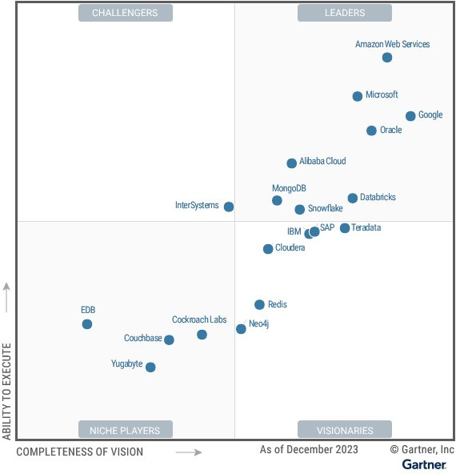
Gartner: Cloud Database Management
Microsoft
Comprehensive Azure Ecosystem
Scalable and Flexible Solutions
Strong Security Features
Seamless Integration Capabilities
Notes:
AWS
Overall cloud leader
Historically focused on AWS ecosystem but changing.
Snowflake
Ease of use
Cloud neutrality (AWS, Azure, Google)
Google
Open and unified Data Cloud
Expanding into enterprise scale

Slide 6
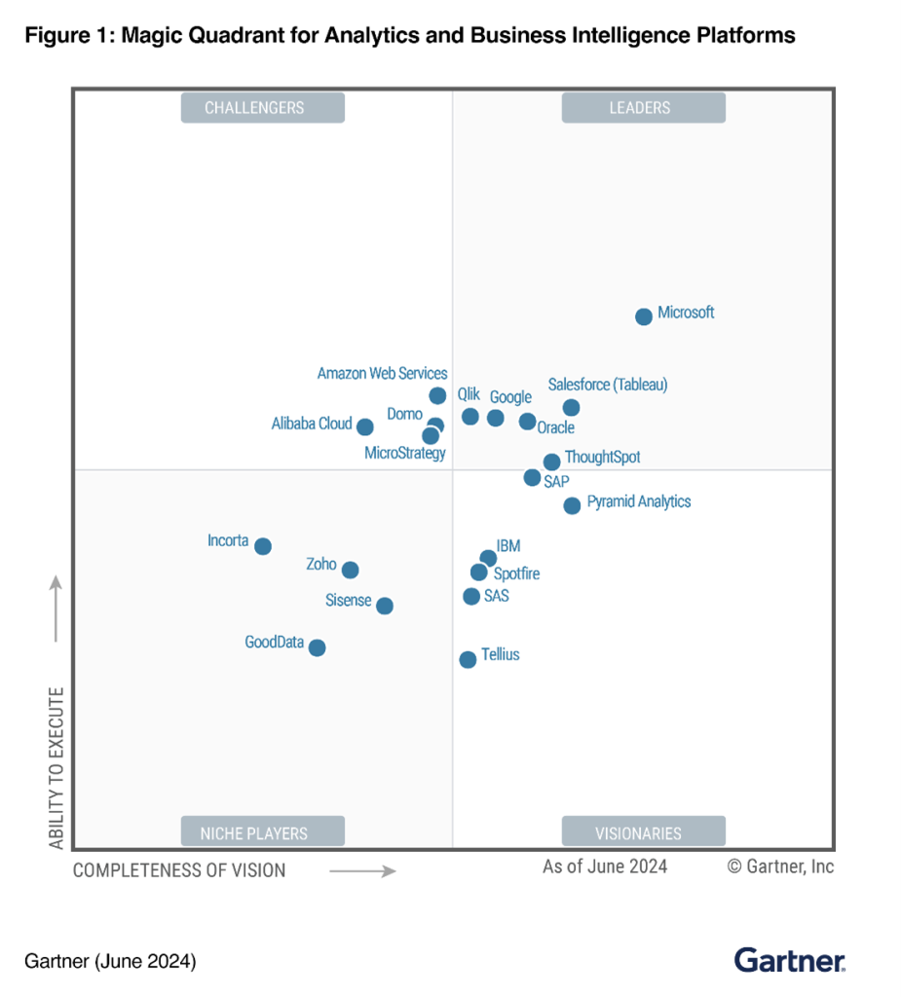
Gartner: Business Intelligence
Microsoft
Alignment with Office, Teams, Synapse / Fabric
Flexible Power BI pricing
Integration with Power Platform
AI-Powered Future
Notes:
Tableau
Powerful visualizations
Salesforce coupling
Tableau AI / Pulse
Domo
Strong ETL and many connectors
Exec oriented
Premium pricing
Google (Looker)
Virtual semantic modeling layer

Slide 7
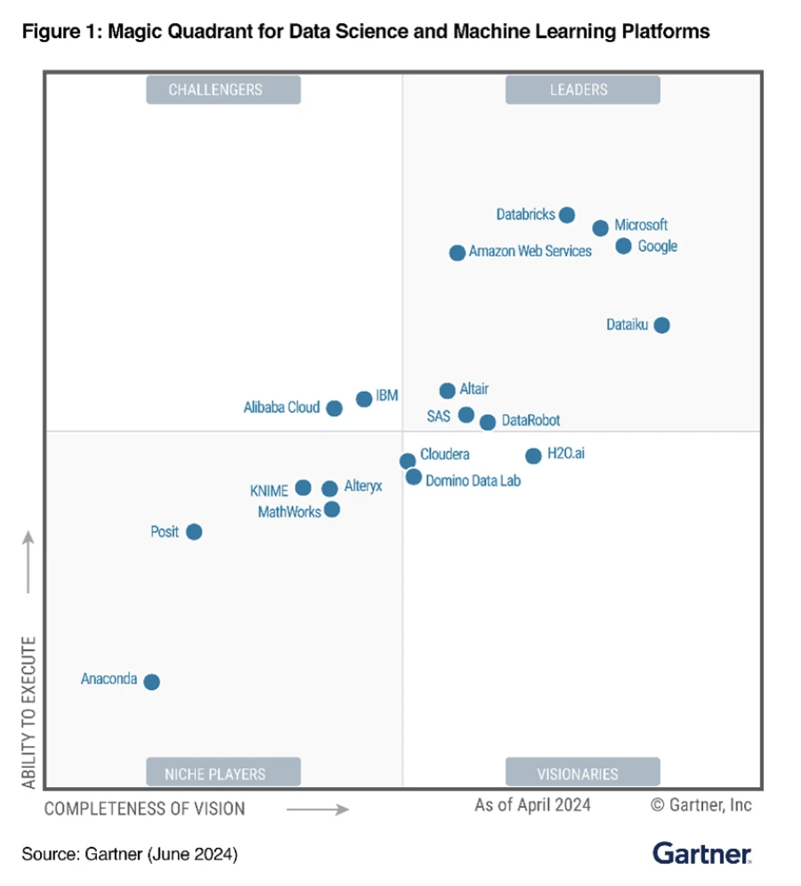
Gartner: Data Science and Machine Learning
Microsoft
Alignment with Synapse / Fabric
Integration with Power Platform
AI-Powered Future

Slide 8
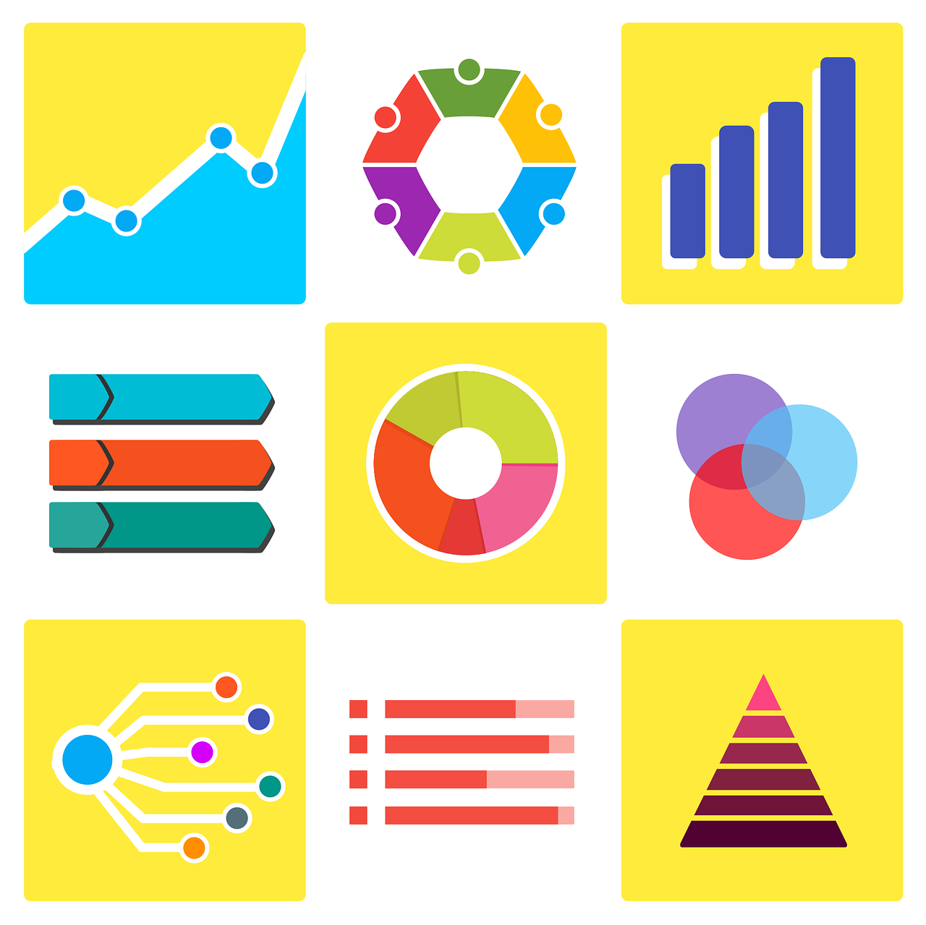
Azure Analytics Options
Various flavors of databases (Postgres, MySQL) and engines (e.g. HDInsight, Databricks) exist.
We’ll focus on:
Power BI
SQL Server
Azure Synapse
Fabric

Slide 9

Export To Data Lake
Deprecation of the Export to Data Lake feature, effective October 15, 2023
You can continue to use it until November 1, 2024*

Slide 10
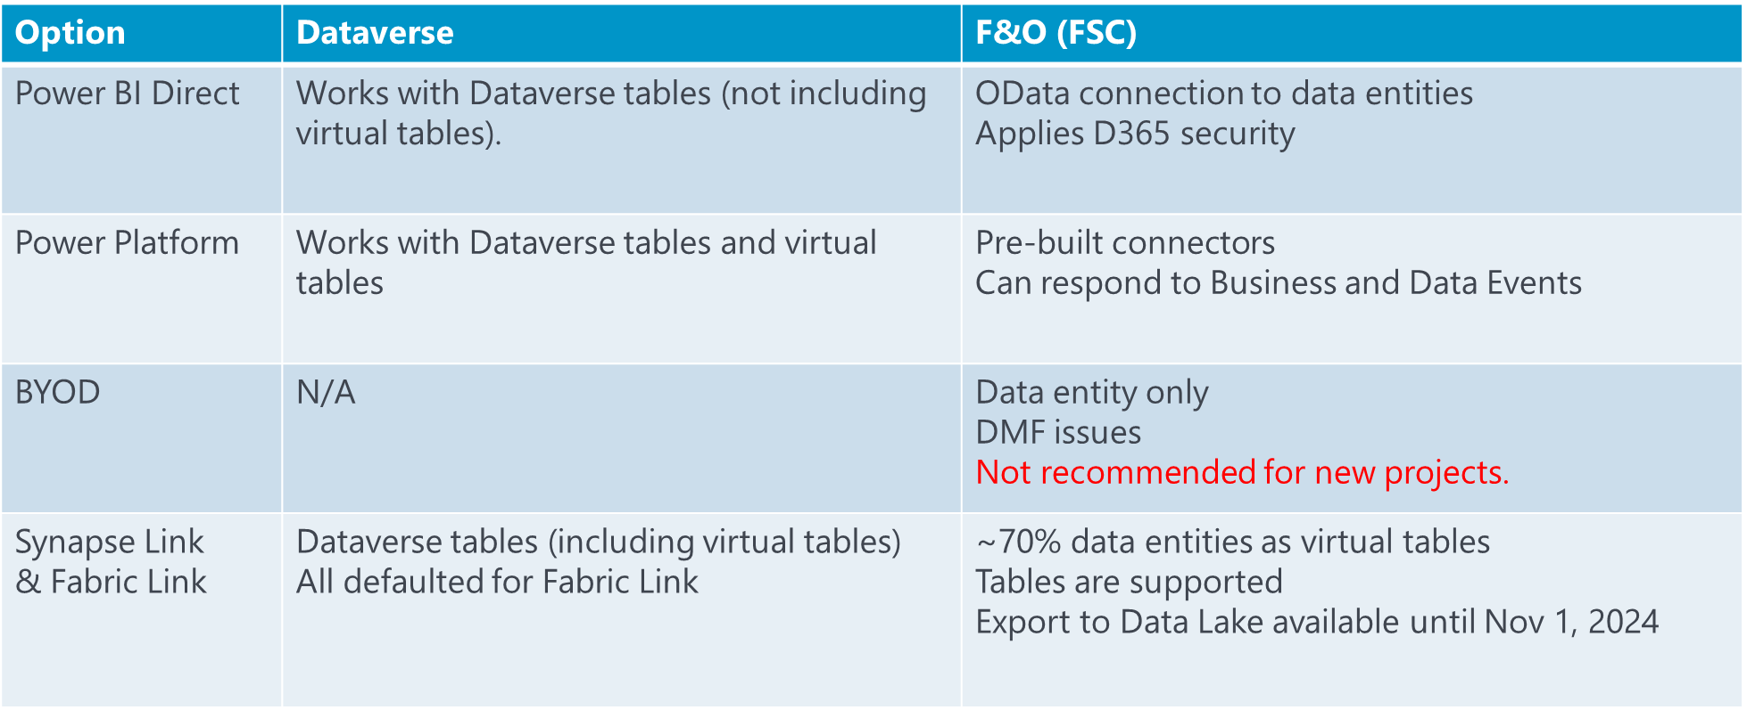
High Level D365 Export Options

Slide 11
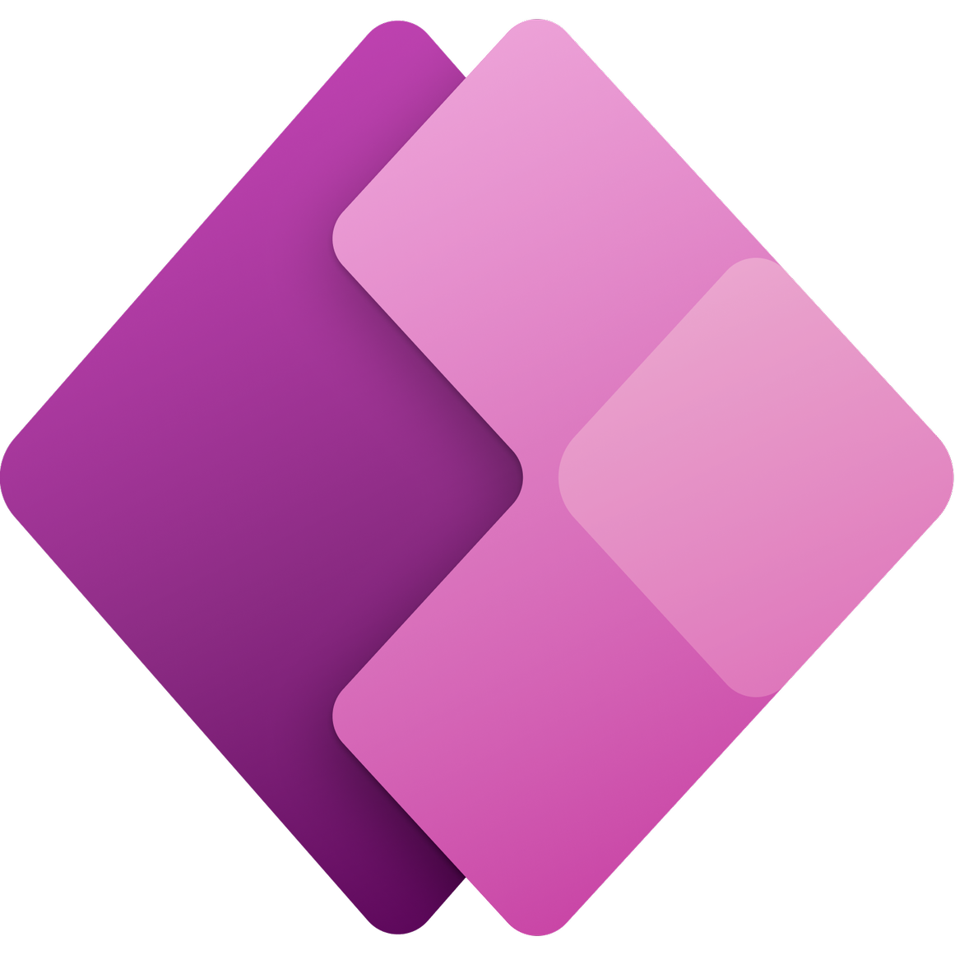
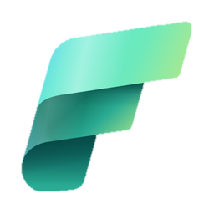
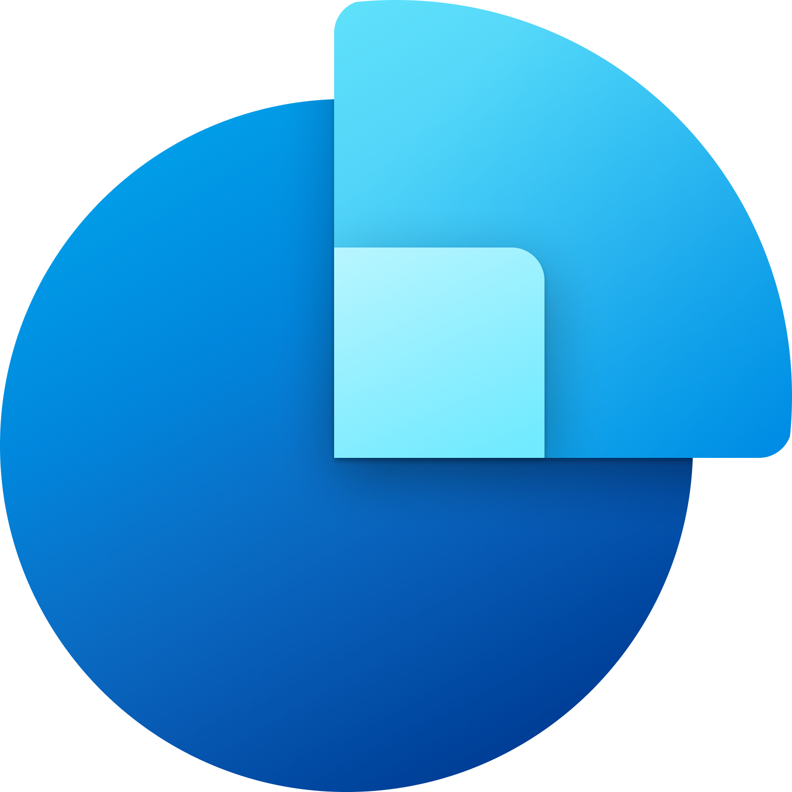




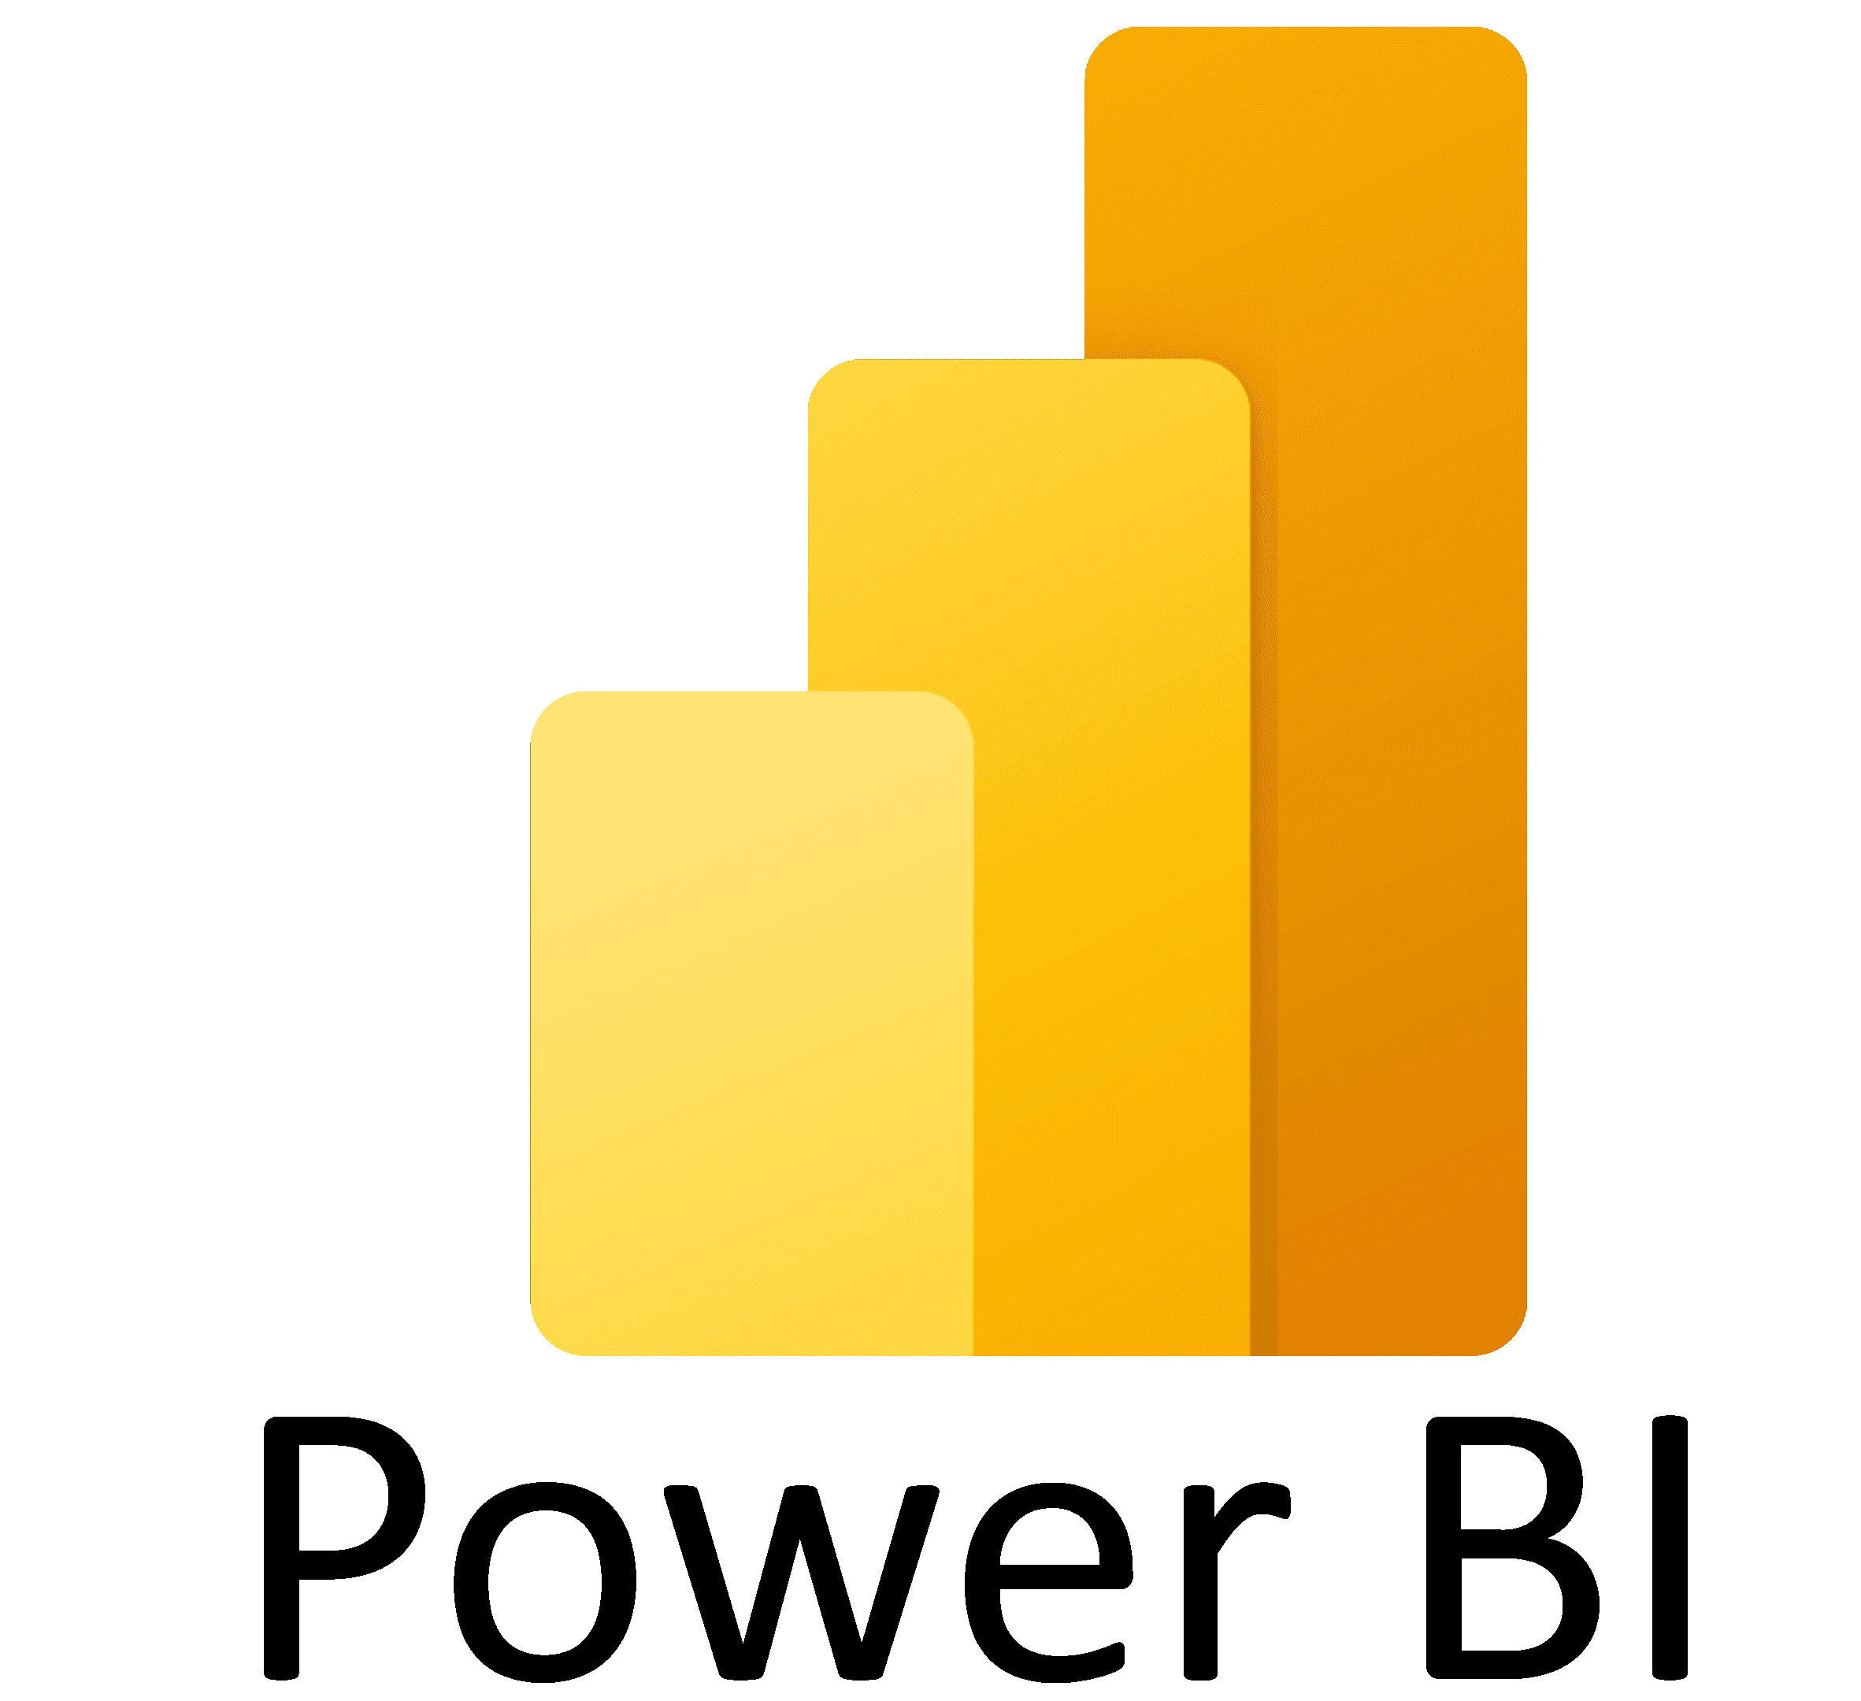


D365/Dataverse Data Convergence
Power Apps
Dynamics 365 Sales
Dynamics 365 Customer Service
Dynamics 365 Field Service
Dataverse
Dynamics 365 Marketing
Dynamics 365 Finance & Supply chain

Slide 12
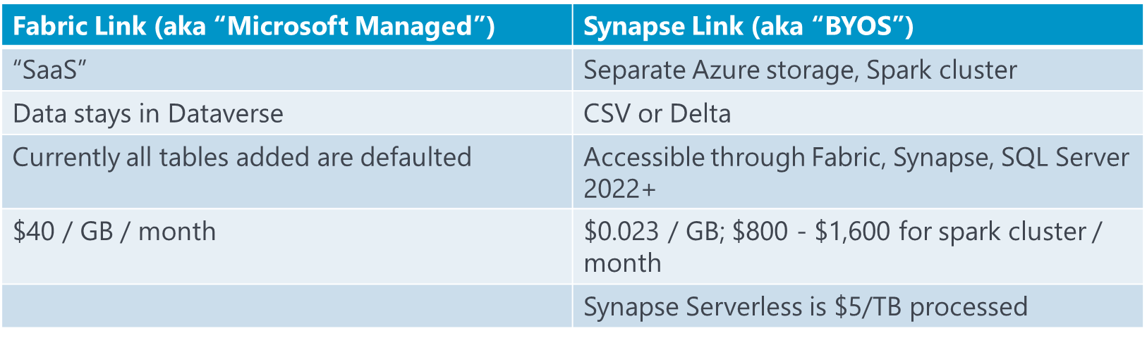
Fabric Link vs Synapse Link

Slide 13
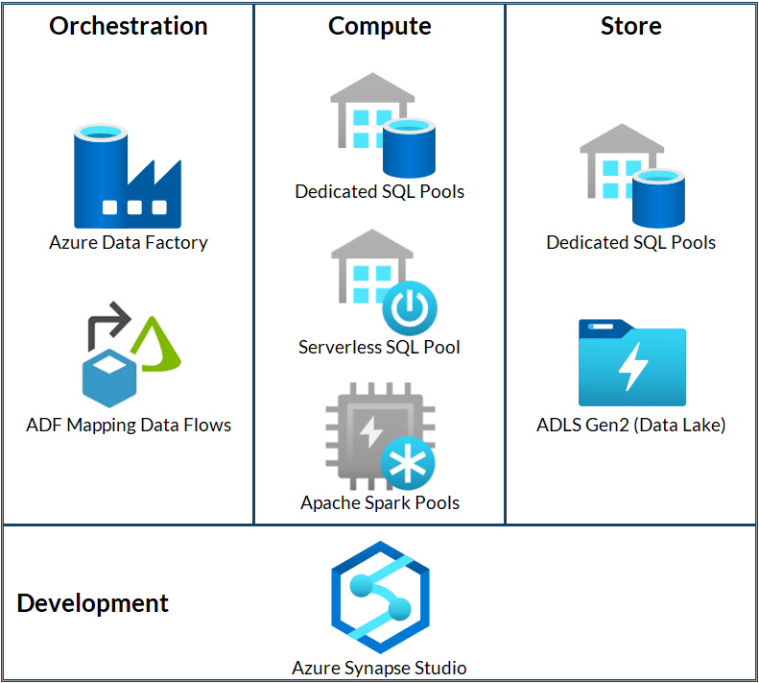
What’s The Difference?
Notes:
This would be if you're doing development in Synapse. Otherwise there are different components if you were to pursue Fabric for instance.

Slide 14
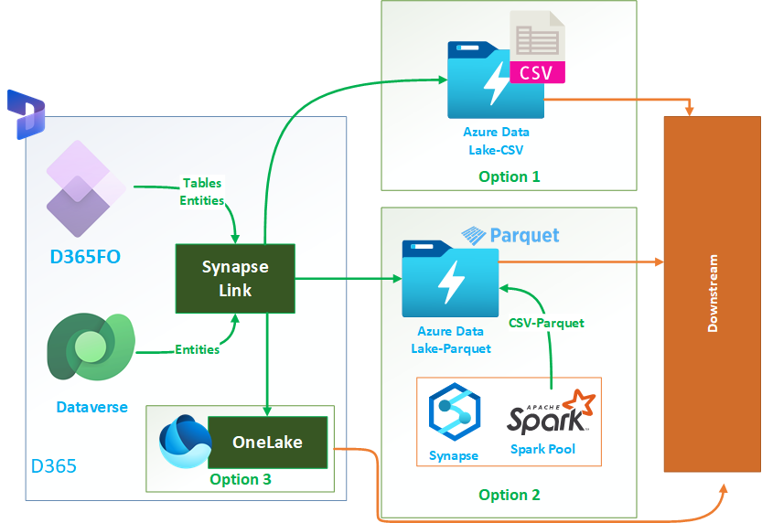
CVS Vs. Parquet
Notes:
https://azureintegrations.com/2023/10/21/export-data-from-d365-fo-using-synapse-link/

Slide 15
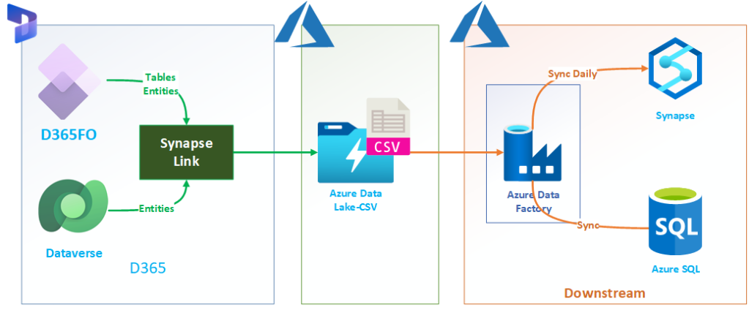
Synapse Link in CSV Format (BYOL CSV)
Notes:
Synapse Link will land an incremental CSV in storage

Slide 16
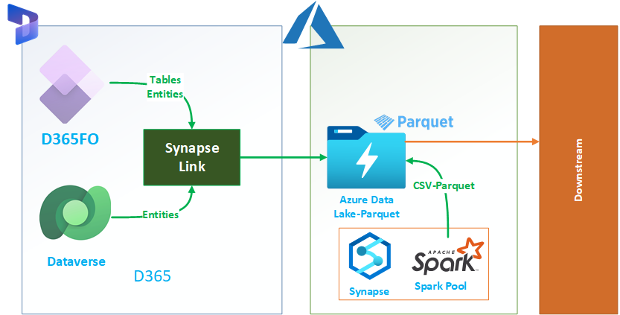
Synapse Link in Delta Parquet Format
Notes:
https://azureintegrations.com/2023/10/21/export-data-from-d365-fo-using-synapse-link/ Synapse Link will land an incremental CSV in storage, and then the spark pool will pick it up for conversion to parquet.

Slide 17
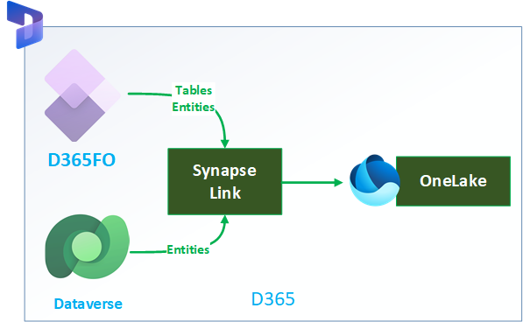
Export to Fabric Link
Notes:
https://azureintegrations.com/2023/10/21/export-data-from-d365-fo-using-synapse-link/

Slide 18
Comparison
Criteria | (Option1) Synapse link BYOL (CSV) | (Option2) Synapse link BYOL (Delta) | (Option3) Microsoft Fabric
Ease of Administration | Customer managed PaaS resources – Storage account | Customer managed PaaS resources – Storage account, Synapse & Spark Pool | Managed by Microsoft
Security | Firewall support on storage account | Firewall support on storage account and synapse workspace | Managed by Microsoft
Query Performance | Data format: CSV No read-write contention when reading completed Incremental update folder. | Data format: Delta No read-write contention as Delta supports ACID Better-read performance | Data format: Delta No read-write contention as Delta supports ACID Better-read performance

Slide 19
Comparison
Criteria | (Option1) Synapse link BYOL (CSV) | (Option2) Synapse link BYOL (Delta) | (Option3) Microsoft Fabric
End-to-End Data Freshness | Data freshness (Configurable): 15 minutes – 24 hours | Data freshness (Configurable): 15 Minutes – 24 hours | Data freshness: ~1 hour
Data Write and Storage Costs | Storage + Transaction cost | Storage + Transaction + Delta conversion – Spark pool cost | Dataverse capacity (entitlement + add-on)
Compute Cost | Downstream data pipeline cost | Downstream data pipeline cost | Fabric capacity cost

Slide 20
References
https://learn.microsoft.com/en-us/power-apps/maker/data-platform/azure-synapse-link-synapse
https://learn.microsoft.com/en-us/power-apps/maker/data-platform/azure-synapse-link-data-lake
https://tldr-dynamics.com/blog/setup-azure-synapse-for-dataverse
https://azureintegrations.com/2023/10/21/export-data-from-d365-fo-using-synapse-link/
Travis Christens @ Armanino - https://www.linkedin.com/in/travischristens/

Slide 21
Resources
Fabric Roadmap: https://learn.microsoft.com/en-us/fabric/release-plan/
Synapse Link Setup: https://learn.microsoft.com/en-us/power-apps/maker/data-platform/azure-synapse-link-select-fno-data
Pipeline for SQL: https://learn.microsoft.com/en-us/power-apps/maker/data-platform/azure-synapse-link-pipelines?tabs=synapse-analytics
Fabric Pricing: https://azure.microsoft.com/en-us/pricing/details/microsoft-fabric/
Fabric Limitations: https://learn.microsoft.com/en-us/fabric/data-warehouse/limitations
T-SQL Limitations: https://learn.microsoft.com/en-us/fabric/data-warehouse/tsql-surface-area#limitations
Dynamics F&O Synapse Link limitations: https://learn.microsoft.com/en-us/power-apps/maker/data-platform/azure-synapse-link-select-fno-data#known-limitations-with-finance-and-operations-tables
Yammer:https://www.yammer.com/dynamicsaxfeedbackprograms/#/threads/inGroup?type=in_group&feedId=32768909312

Slide 22

Questions?

